Slide 1

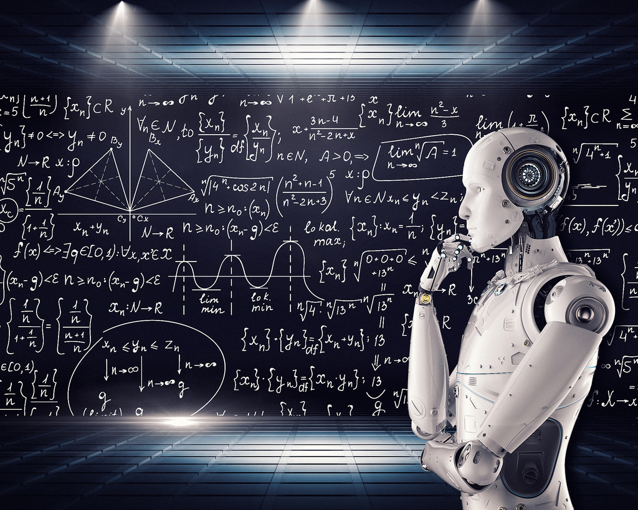
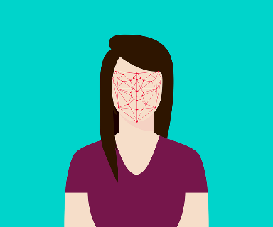



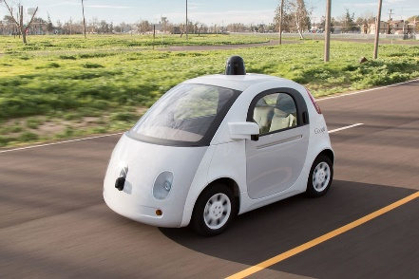
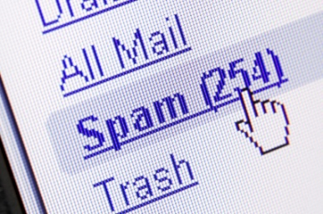
MACHINE LEARNING AND ARTIFICIAL INTELLIGENCE: INTRODUCTION
Artificial Intelligence/Machine learning does not only mean robots or Sci-Fi movies!
Machine learning applications are everywhere!
Google search engine, amazon recommender systems, Facebook facial recognition (tagging), Siri

Slide 2

MACHINE LEARNING AND ARTIFICIAL INTELLIGENCE: PROCESS
Machine learning is the study of algorithms that teach computers to learn from experience.
Through experience (more training data), computers can continuously improve their performance.
STEP 1
STEP 3
STEP 5
Feed training data
Find patterns
Learn from experience
STEP 2
STEP 4
Analyze Data
Perform prediction/Make a decision

Slide 3
MACHINE LEARNING: BIG PICTURE
ARTIFICIAL INTELLIGENCE
Science that enables computers to mimic human intelligence. Subfields: Machine Learning, robotics, and computer vision
MACHINE LEARNING
Subset of AI that enable machines to improve at tasks with experience
SUPERVISED LEARNING
Training algorithms using labeled input/output data.
CLASSIFICATION
REGRESSION
UNSUPERVISED LEARNING
Training algorithms with no labeled data. It attempts at discovering hidden patterns on its own.
CLUSTERING
REINFORCEMENT LEARNING
Algorithm take actions to maximize cumulative reward.

Slide 4
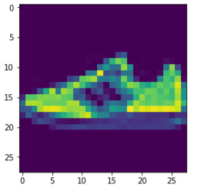
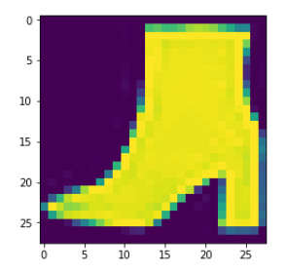
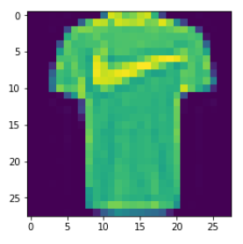
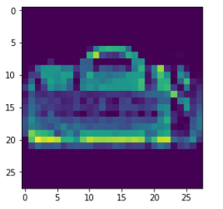

MACHINE LEARNING: SUPERVISED LEARNING
Supervised: used to train algorithms using labeled input and output data.
Performance is assessed by comparing trained model prediction vs. real output.
DESIRED OUTPUT
TARGET CLASSES (LABELS)
y _train
INPUT DATA
$$X _train$$
T-SHIRT/TOP
TROUSER
PULLOVER
DRESS
COAT
SANDAL
SHIRT
SNEAKER
BAG
ANKLE BOOT
MODEL

Slide 5
MACHINE LEARNING: UNSUPERVISED LEARNING
Unsupervised learning: provides the algorithm with no labeled data.
The algorithm attempts at discovering hidden patterns within the training data.
Unsupervised learning methods can analyze complex data that humans might find difficult to interpret.
No feedback!
DATA CLUSTERS
INPUT DATA
MODEL

Slide 6
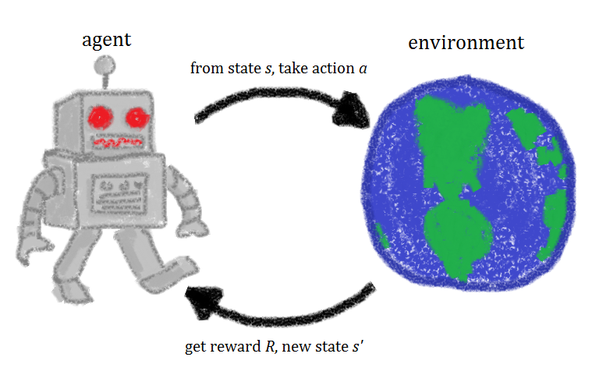

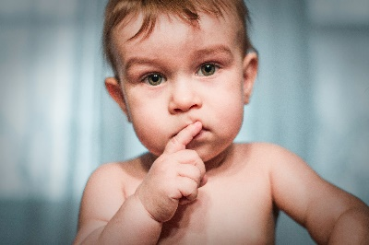

MACHINE LEARNING: REINFORCEMENT LEARNING
Reinforcement learning allows machines take actions to maximize cumulative reward.
Reinforcement algorithms learn by trial and error through reward and penalty.
Two elements: environment and learning agent.
The environment rewards the agent for correct actions.
Based on the reward or penalty, agent improves its environment knowledge to make better decision.
ENVIRONMENT
AGENT
-10 Points
+10 Points
https://commons.wikimedia.org/wiki/File:Rl_agent.png

Slide 7
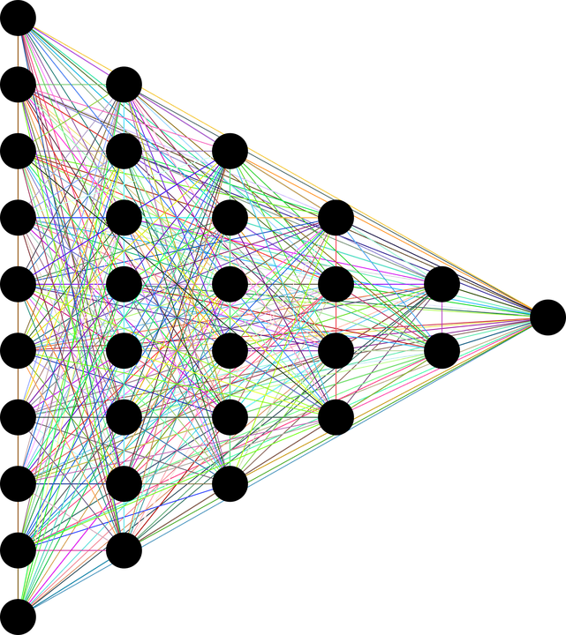
MACHINE LEARNING: DEEP LEARNING
Deep learning is a subset of machine learning that utilizes multi-layer Artificial Neural Networks.
Deep Neural Networks are inspired by the human brain and mimics the operation of biological neurons.
Artificial Intelligence
Machine Learning
Deep Learning
INPUT DATA
TARGET OUTPUTS
Photo Credit: https://pixabay.com/en/neural-network-thought-mind-mental-3816319/
DEEP (HIDDEN LAYERS)

Slide 8
MACHINE LEARNING: WHICH TECHNIQUE SHOULD BE USED?
Classification
Discrete outputs 0,1
Regression
Simple Linear Regression
Polynomial Regression
Clustering
K-Means Clustering
Support Vector Machines
Naïve Bayes
Random forest
K Nearest Neighbours
Logistic regression
Multiple Linear Regression
Predicting continuous values such as temperature
No labelled data
Finding Patterns in data is required
Market segmentation

